Slide 1
Game Development 2B
Design Patterns

Slide 2

Design patterns and solving problems
Someone has already solved the problem you have
Design Patterns are an extension of that
A way to structure and design your code for better extension and integration with other patterns
Unlike data structures, patterns are about recognizing where a pattern is useful and applying it to a given situation

Slide 3
The problem with inheritance
Inheritance allows us to easily give functionality to a subclass
01
If a subclass doesn’t override the functionality, it just uses our parent class’s implementation
02
Why could this be a problem?
03

Slide 4
The problem with inheritance
There’s no way to turn off functionality
1
Overriding implementations to do nothing
2
What happens when you have hundreds or thousands of subclasses?
3

Slide 5
Solving the problem with interfaces
We can create interfaces to separate out “plug and play” implementations for different interfaces
01
Health interface, Damage interface
02
What is the core problem here?
03

Slide 6
Solving the problem with interfaces
Interfaces are abstract
They don’t define implementations for their method signatures
They require each class to have custom overrides

Slide 7
Solving the problem with design patterns
Identifying code that needs to stay the same, and what will vary from implementation to implementation
1
Separating the varied implementation out into its own class or class hierarchy
2
HP, Damage etc were interfaces, but they can now be classes that our objects can have instance variables of
3
Changes the way of thinking: A class is no longer just an object, it can also represent a set of behaviours
4

Slide 8
Solving the problem with design patterns
Program to an abstraction, not an implementation
Use abstractions to structure your code, as implementations can differ between concrete subtypes

Slide 9
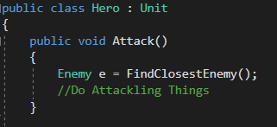
Programming to an implementation

Slide 10
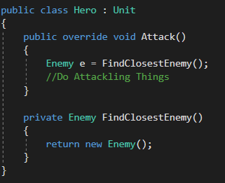

Programming to an abstraction

Slide 11
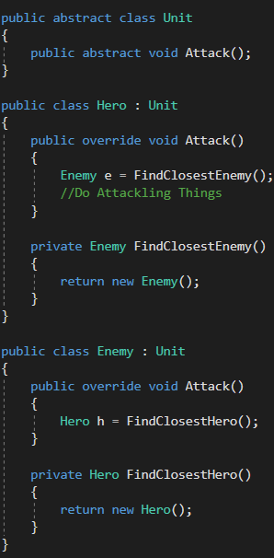
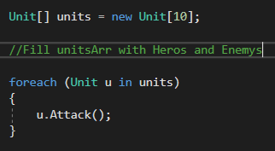
Getting typing at runtime

Slide 12
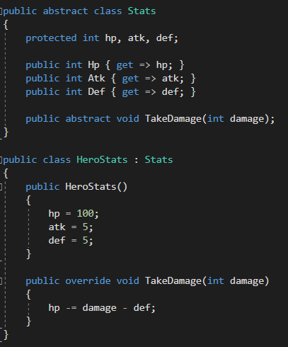
delegation
Using these behavioural “interfaces” to handle functionality

Slide 13
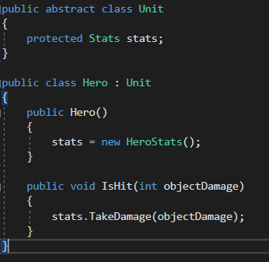
delegation
Using these behavioural “interfaces” to handle functionality

Slide 14
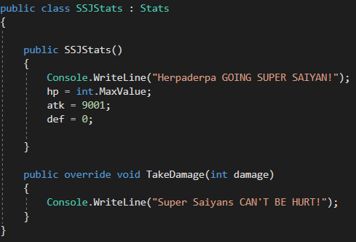
Changing behaviours on the fly
Kind of like a State Machine
Create multiple states for any behavior to be in

Slide 15
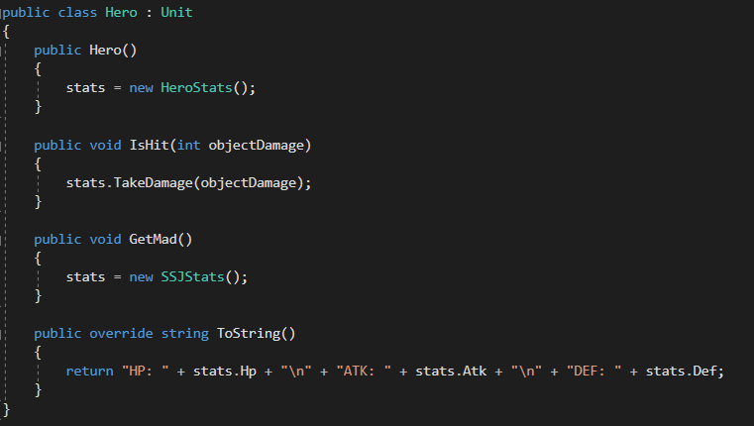
Changing states

Slide 16
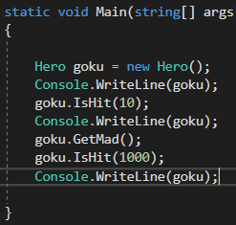
testing

Slide 17
Composition over inheritance
Design patterns move to focus on composition rather than inheritance
1
Composition of hierarchical class structures
2
Unity does this really well inherently due to its component model
3

Slide 18
You just implemented the strategy pattern
The Strategy Pattern defines a family of algorithms, encapsulates each one, and makes them interchangeable. Strategy lets the algorithm vary independently from clients that use it.

Slide 19
A different language
Shared pattern vocabularies are POWERFUL.
When you communicate with another developer or your team using patterns, you are communicating not just a pattern name but a whole set of qualities, characteristics and constraints that the pattern represents.
Patterns allow you to say more with less.
When you use a pattern in a description, other developers quickly know precisely the design you have in mind.
Talking at the pattern level allows you to stay “in the design” longer.
Talking about software systems using patterns allows you to keep the discussion at the design level, without having to dive down to the nitty gritty details of implementing objects and classes.
Shared vocabularies can turbo charge your development team.
A team well versed in design patterns can move more quickly with less room for misunderstanding.
Shared vocabularies encourage more junior developers to get up to speed.
Junior developers look up to experienced developers. When senior developers make use of design patterns, junior developers also become motivated to learn them. Build a community of pattern users at your organization.

Slide 20
